Slide 1

Exploratory Data Analysis
Ian Paulino Velez – Solo Banking Group
16-Oct-2023

Slide 2

Agenda
Executive Summary
Approach
EDA
Conclusion and Recommendations
Machine Learning proposal

Slide 3
Executive Summary
ABC Bank wants to sell its term deposit product to customers and before launching the product they want to develop a model to help them understand whether a particular customer will buy their product or not (based on customer's past interaction with bank or other Financial Institution).
After analyzing our data, we have drawn relationships between important variables and outlined a group of customers to focus on during the marketing campaign based on these relationships, as well as proposed some machine learning techniques to make our predictions.

Slide 4
Approach
The questions will be answered using Exploratory Data Analysis consisting of preliminary table exploration, some necessary table calculations and transformations, and exploratory data visualizations. We will mainly be visualizing our explanatory variables in relation to our target variable 'subscription' (our 'y', or more specifically,whether or not the person subscribed a term deposit or not).

Slide 5
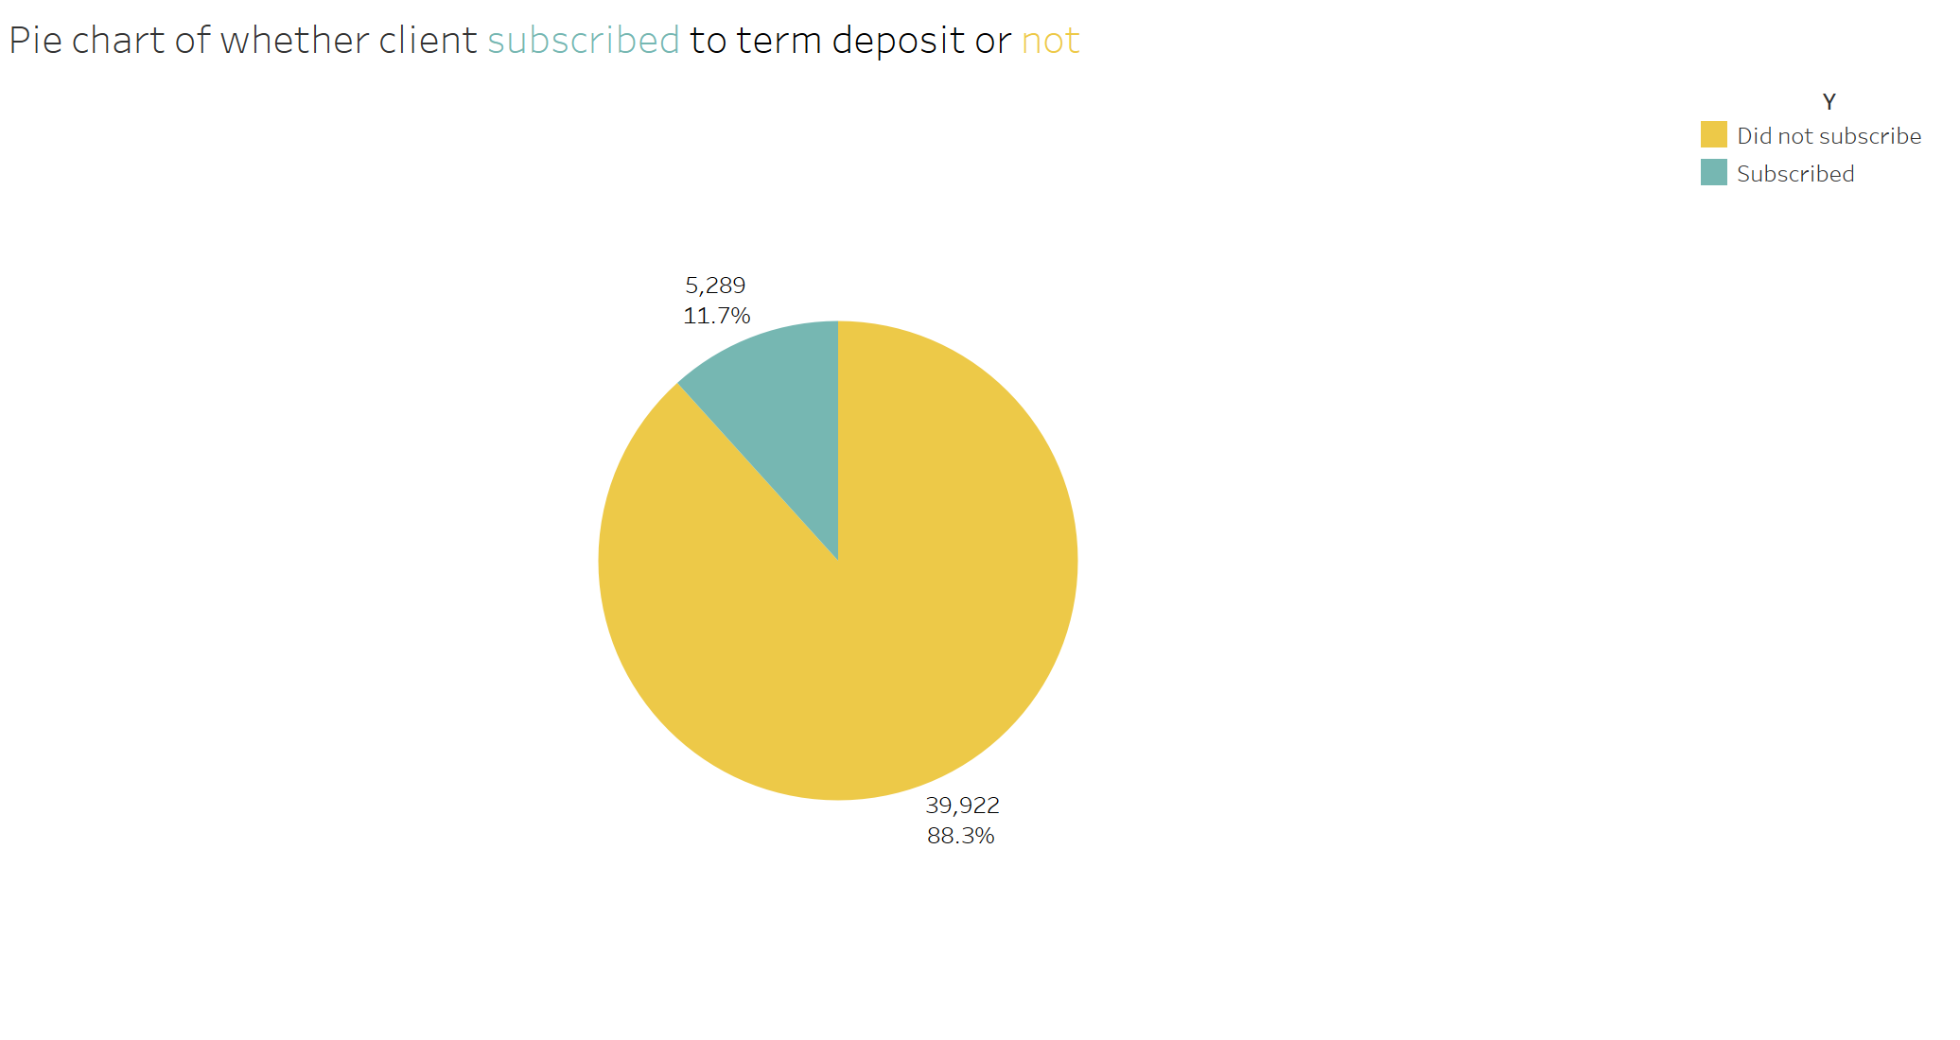
Exploratory Data Analysis
Our data consists of one table with 45,211 rows of data and 17 features, including the target, where only 7 of these are numerical. Our aim is to predict whether a customer will subscribe to a term deposit or not based on their characteristics or those of their interaction (phone call) with our organization.
These are the current results we are handling for the target variable (Y). Our data seems to be highly imbalanced, with only about 12% of people subscribing to the term deposit.

Slide 6
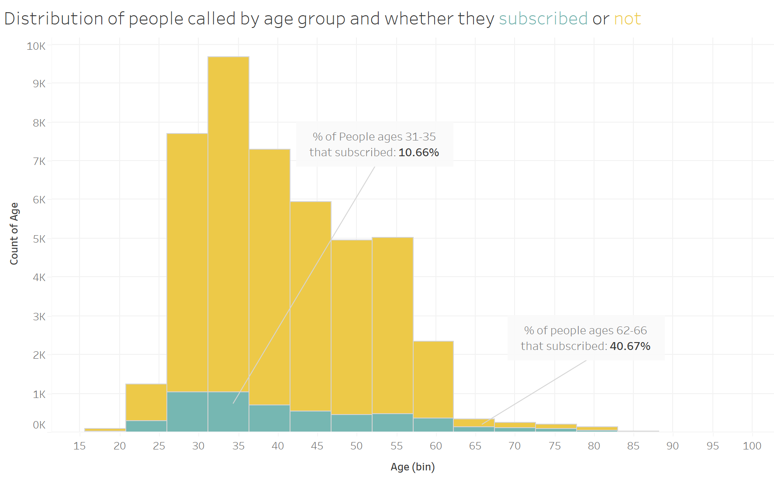
Exploratory Data Analysis
With the bulk of the people in our data being between 25 and 60 years of age, it is worth noting the proportion of people that subscribed is considerably higher for older people (about 40% on the last four groups), although it is not very noticeable because the total amount of those people in our data is very low in comparison to younger adults.

Slide 7
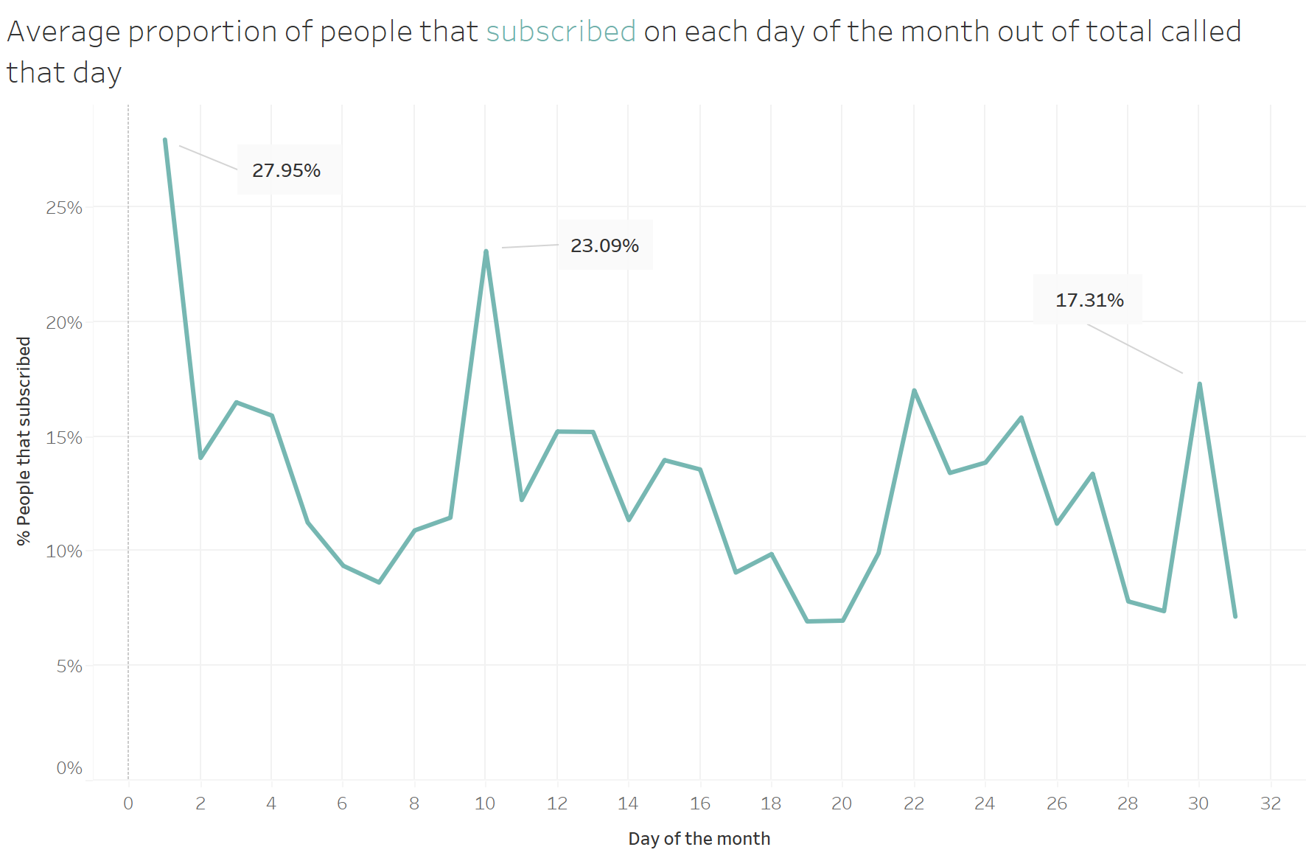
Exploratory Data Analysis
People called at the beginning of the month were, on average, more inclined to subscribe a term deposit - especially the first day, where about 28% of all people did so. Although this proportion has peaks, notably on days 10, 22 and 30, it descends consistently as the month goes by.

Slide 8
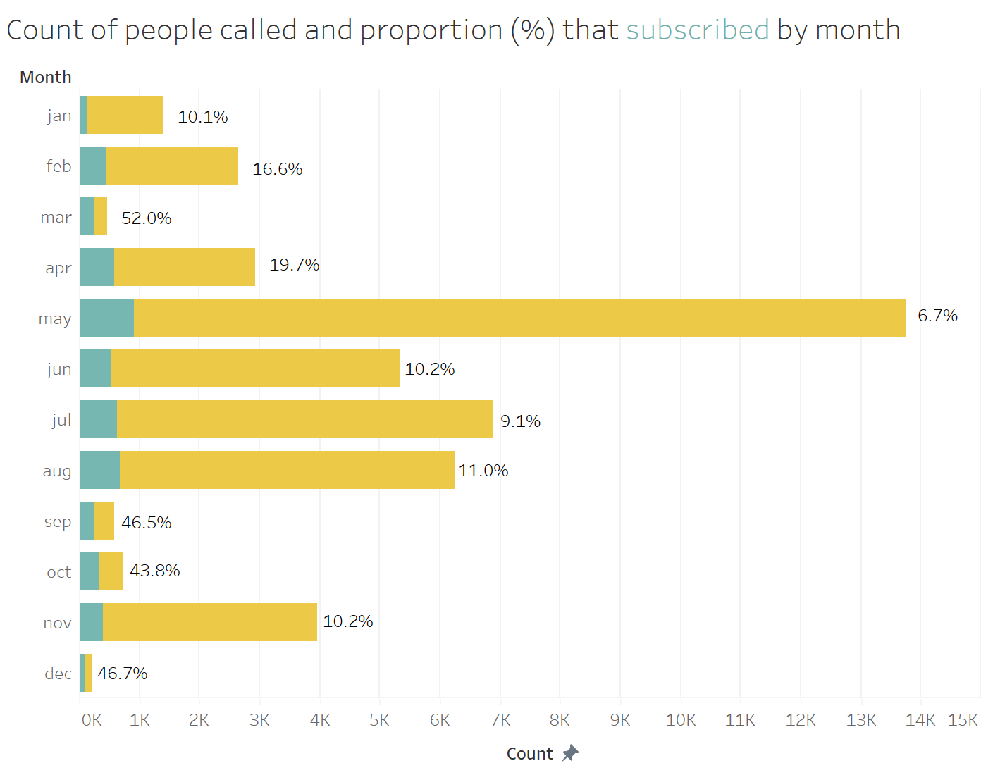
Exploratory Data Analysis
Now, let's check some overlapping stacked bar graphs to measure how many people subscribed a term deposit and which categorical groups are the most inclined to subscribe, based on the proportion that did so out of the people called.
Although May holds the most people called by far, the proportion of those that subscribed is relatively low. Other months like March, April, September, and October had a higher success rate.

Slide 9
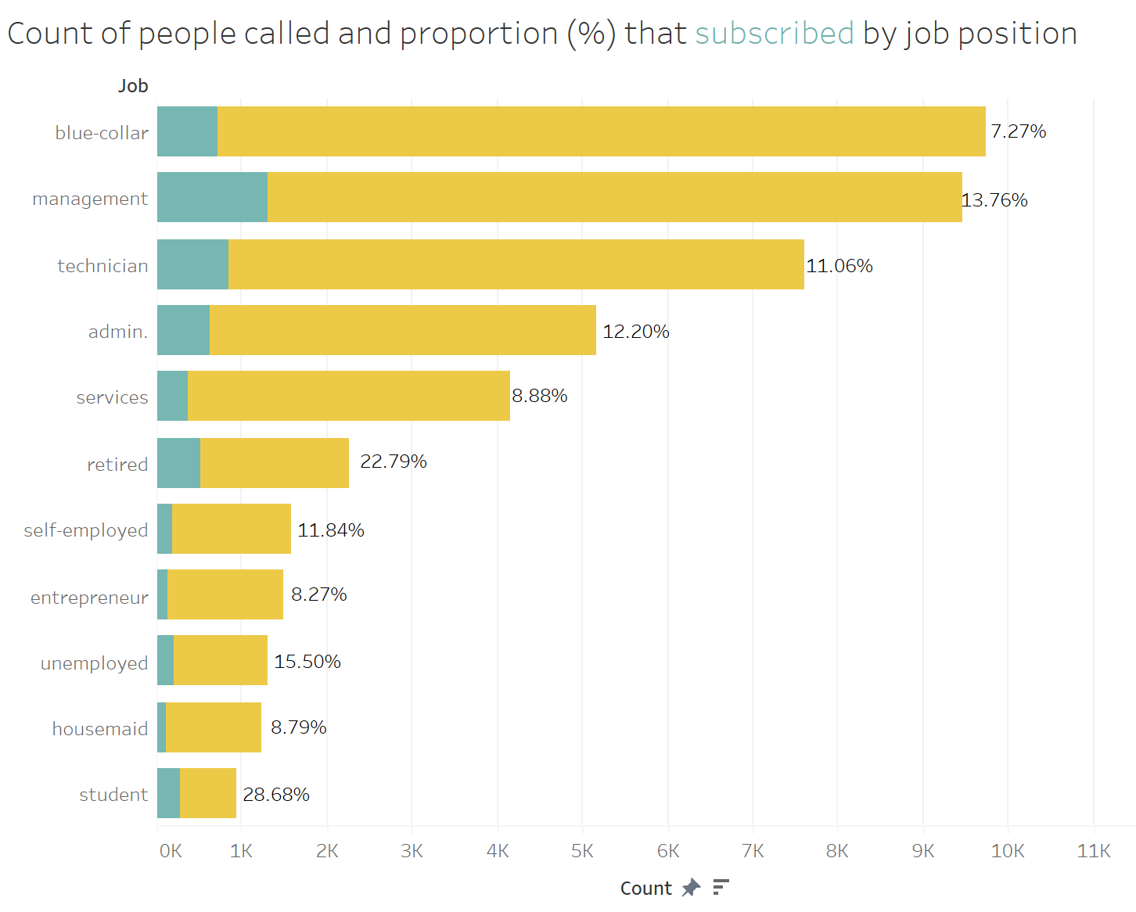
Exploratory Data Analysis
Similarly, while most people called had blue-collar jobs, much more people from management and technician jobs actually subscribed a term deposit. In terms of proportions, students and retired people were more inclined to subscribe with over 20% in proportion.

Slide 10
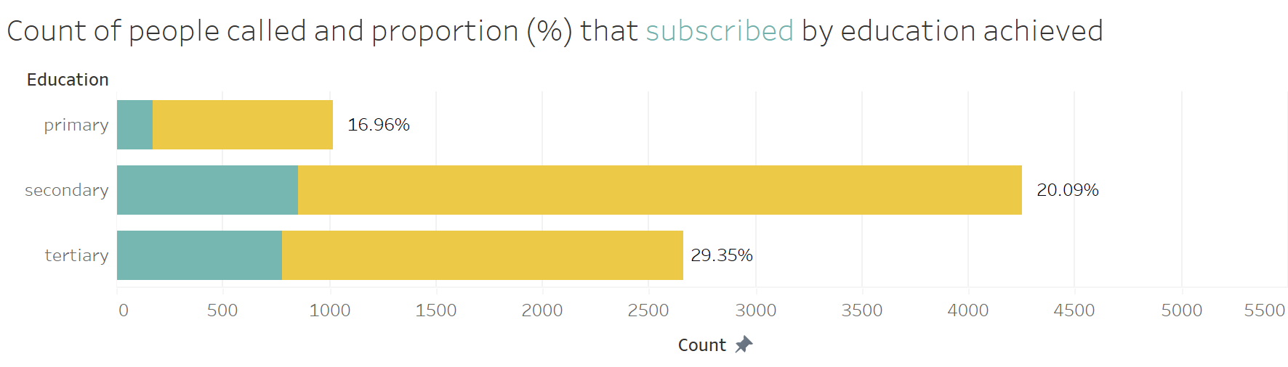
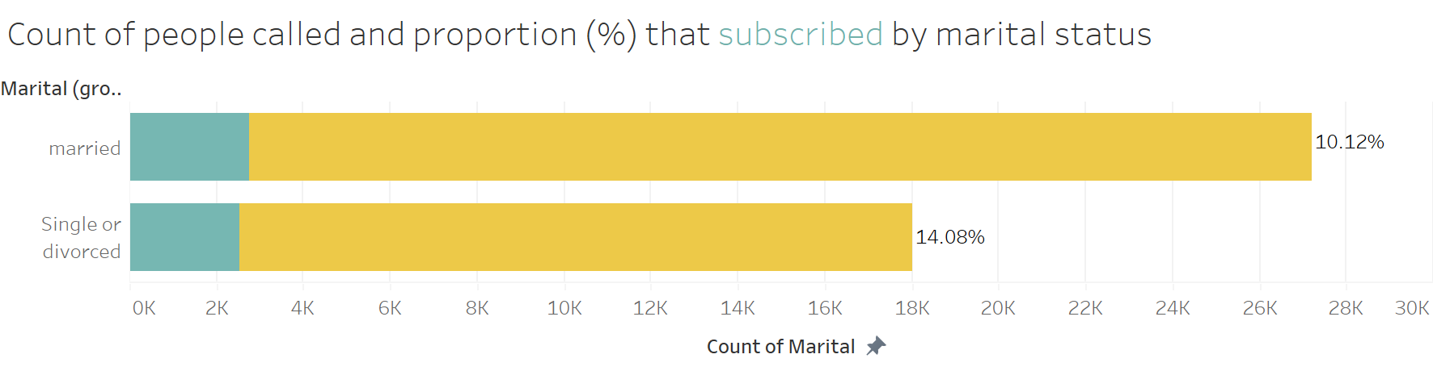
Exploratory Data Analysis
People with secondary education seemed to be the most called, but people with tertiary education subscribed the most, with almost 10% more people accepting the offer under that group.
And people who were not married were also most likely to accept the offer.

Slide 11
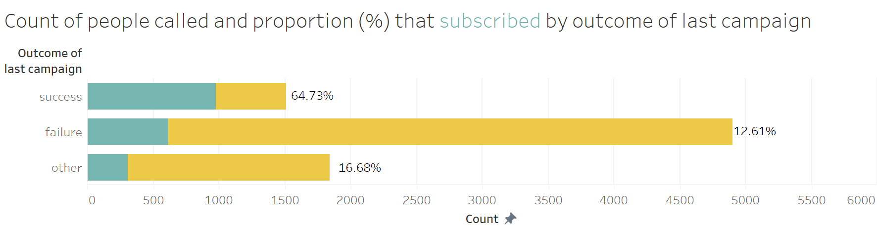
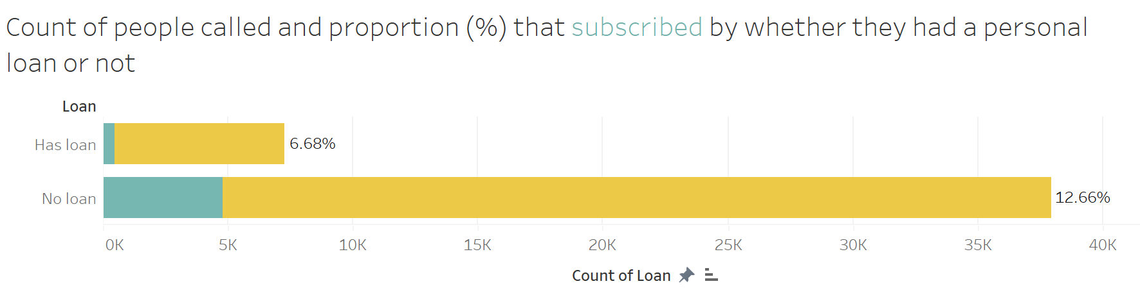
Exploratory Data Analysis
With very substantial evidence, people who accepted the offer during the last campaign were more likely to accept this one than people who didn’t.
Finally, it is worth noting that people with personal loans were not too interested in subscribing a term deposit.

Slide 12
Conclusion and Recommendations
Based on the data, the main conclusion is that the marketing should generally veer toward people that fit the following profile:
Retired people and students
People with +65 years of age
People that have achieved tertiary education
People that are not married
People without a personal loan
People on who the last marketing campaign was successful
Certain dates are also more recommended to reach out to these people, such as the beginning of the months of March, October, and December.
It is worth noting that, for the most part, the data collected for these specific categories of these variables were often very few, as opposed to other categories with less acceptance rates of the product. For example, the month of May saw many calls, but the number of people that subscribed a term deposit out of the total that were called in May was much lower than the aforementioned months, despite them holding much less calls in total. This may give us a hint as to why the dataset is so imbalanced towards people that could not be persuaded.

Slide 13
Machine Learning Proposal
Our dataset has the following characteristics:
Highly imbalanced
Most numerical variables are skewed
Target variable is non-linearly separable on all sets of two-dimensional planes
Target variable is binary (only two classes to predict)
Existence of missing values in some cases (which for some ML algorithms we will try to impute and then compare results)
Most of the important and usable variables are categorical and hold a wide variety of categories, making one-hot encoding return a much larger dataset
Given this information, we will implement K-NN on data ignoring outliers, and then implement both Random Forest Classifier and Support Vector Machines and compare metrics, due to their ability to handle categorical variables, class imbalance, high dimensionality and skewness better than other algorithms.
Github repo link where this will be implemented:
https://github.com/ianpv04/Data-Glacier-Project.git

Slide 14
Thank You

